Slide 1
Justin Tucker: The G.O.A.T (and it’s not even close)

Slide 2
What is FGOE?
Field Goal % Over Expected
Metric created to more accurately judge the output of NFL place kickers
Model estimates probability that kick is made

Slide 3
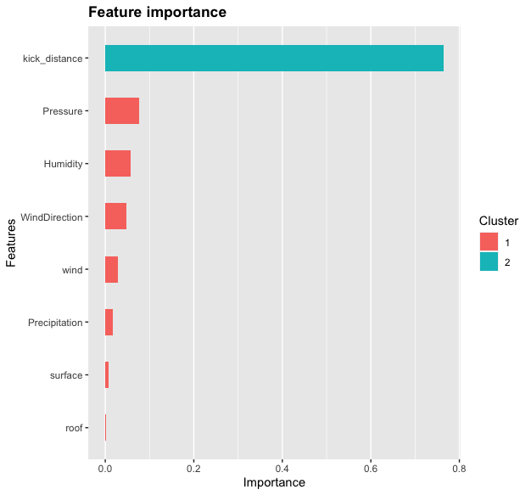

Slide 4
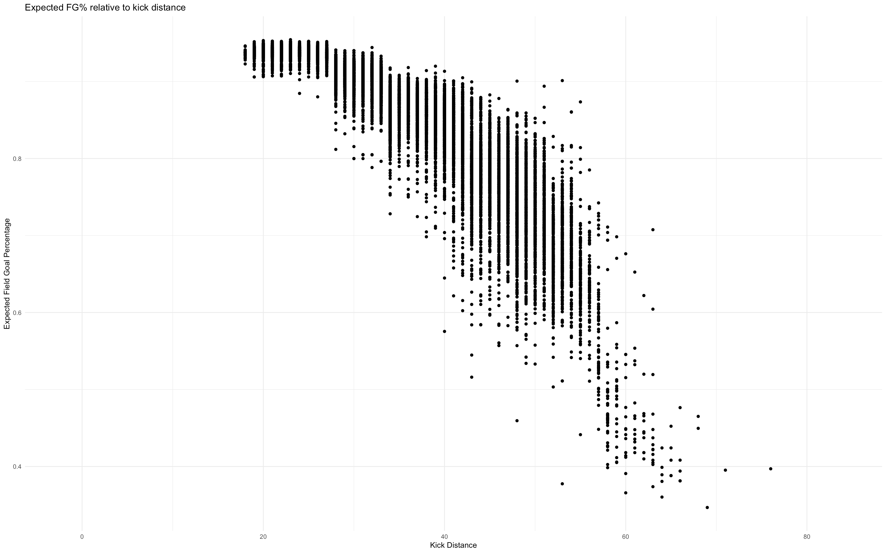

Slide 5
The G.O.A.T Kicker (?)
What makes a G.O.A.T?
Longevity
Peak
Accolades
Overall Numbers

Slide 6
The Case for Adam Vinatieri
Accolades
24 seasons
3x All-Pro
6x Pro Bowler
4(!!!) Super Bowl rings
All-time leader in points scored
All-time leader in Field Goals made
Kicked a game winning field goal in the Super Bowl…twice!!

Slide 7
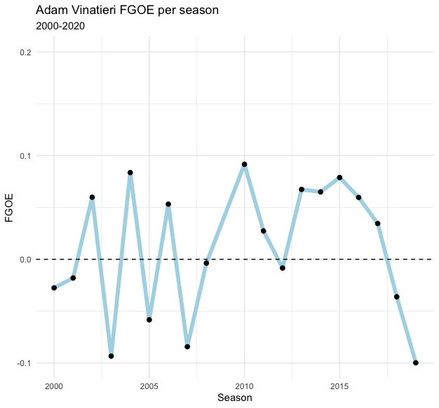
Adam Vinateiri: Why isn’t he the G.O.A.T?
Career FGOE: 0.011
Ranks 32nd out of 66 qualified kickers
Highest FGOE: 0.092 (2010)
Lowest FGOE: -0.100 (2019)
Highly volatile results year-to-year

Slide 8
The Case for Justin Tucker
Accolades
8 seasons
4x All Pro
3x Pro Bowler
1x Super Bowl Champ
Incredible Singer
Pretty much less accomplished than Vinatieri across the board…

Slide 9
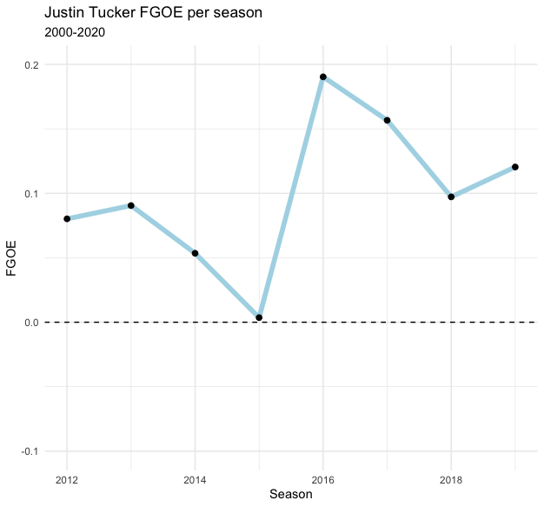
Justin Tucker: The G.O.A.T We Deserve
Career FGOE: 0.098
Ranks 1st out of 66 qualified kickers
Higher than Vinatieri’s best season
Highest FGOE: 0.190 (2010)
Lowest FGOE: 0.004 (2019)
Positive FGOE every year

Slide 10
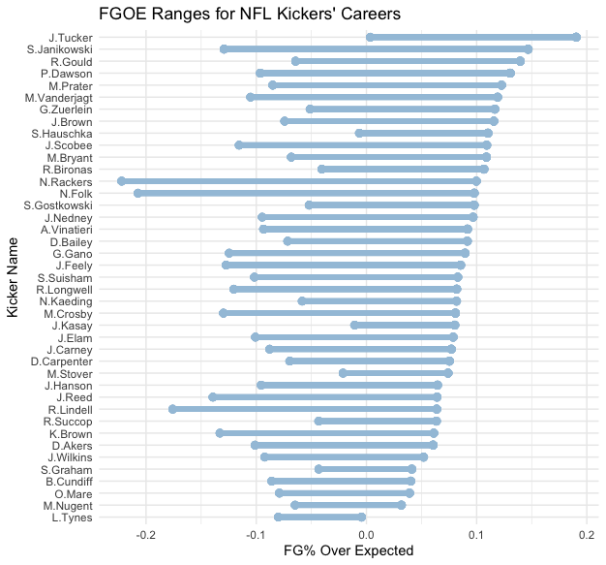

Slide 11
Is Justin Tucker a Hall of Famer?
Short Answer: Maybe
Small sample size prevents us from making a concrete decisions
If Vinatieri or Gostkowski make the Hall then Tucker will almost certainly make it
Kicking Standards tend to be volume based

Slide 12
Acknowledgements
Play-by-play data is from @nflfastR
Ben Baldwin (@benbaldwin)
Sebastian Carl (@mrcaseb)
https://github.com/mrcaseb/nflfastR
Weather Data is from Tom Bliss (@datawithbliss)
Special thanks to Zach Feldman for a great outline of how to use xgboost
https://github.com/z-feldman
Timo Riske (@pff_moo) published a piece on FGOE before I developed my model
https://www.pff.com/news/nfl-pff-data-study-how-confident-can-we-be-in-kickers

Slide 13
Where to find me
Twitter: @BenKeener4
Github: https://github.com/benKeener/Field-Goals-over-expected
Make sure to check out yards per fantasy!
https://yardsperfantasy.com/
Original Reddit Article
https://www.reddit.com/r/nfl/comments/hyt7fw/justin_tucker_the_goat_kicker_and_its_not_close/

